Slide 1
PTM EBS- Value Capture
Kunle Ajayi

Slide 2
March 2024

Slide 3
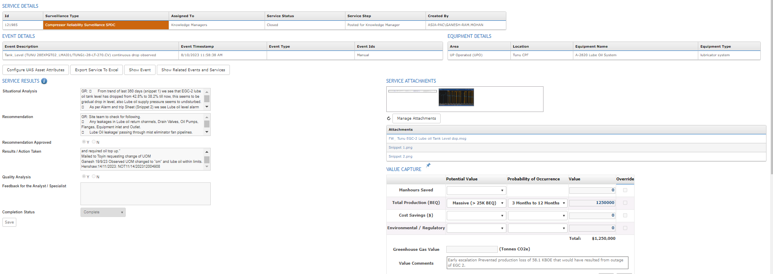

Slide 4
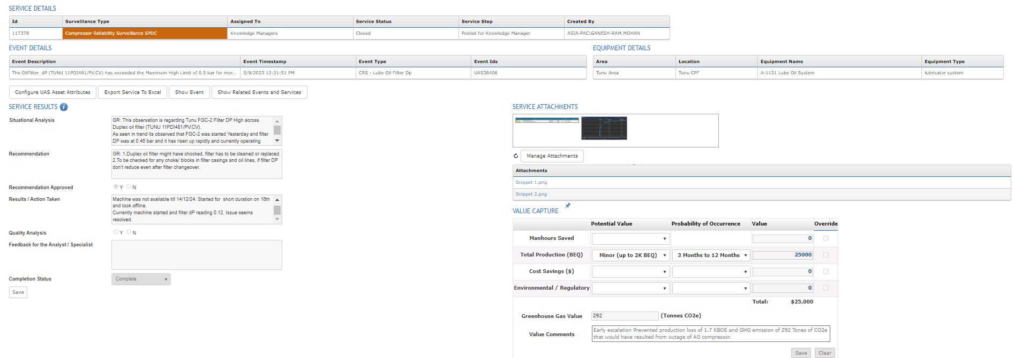

Slide 5
